Slide 1

Capston Project Marketing and Retail Analytics

Slide 2

Agenda
Objectives
Background
Visualizations
Insights
Recommendations
Appendix –
Data Sources
Data Methodology
Data Assumptions

Slide 3

Objective
To optimize inventory management practices.
To identify top products contributing to revenue.
To analyze customer purchasing patterns for insights.
To perform market basket analysis to understand product associations.
To use Pareto analysis to identify high-impact product categories.

Slide 4
Background
E-commerce Company: OList, an e-commerce platform that experienced recent losses.
Challenges: High inventory costs, lack of inventory optimization, and customer purchasing pattern changes.
Data Overview: The dataset includes orders, order items, products, customers, and payments.

Slide 5

Analytics

Slide 6
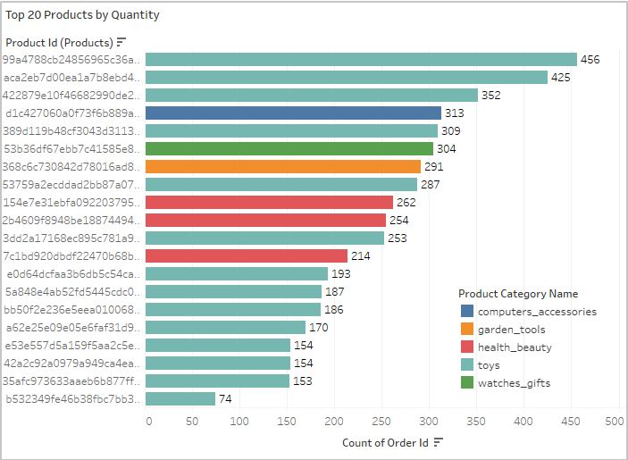
Visualizations Top 20 Ordered Products by Quantity
The most frequently ordered product, with 456 orders, is from the Toys category.
Additionally, the majority of the top 20 best-selling products also fall under the Toys category.

Slide 7
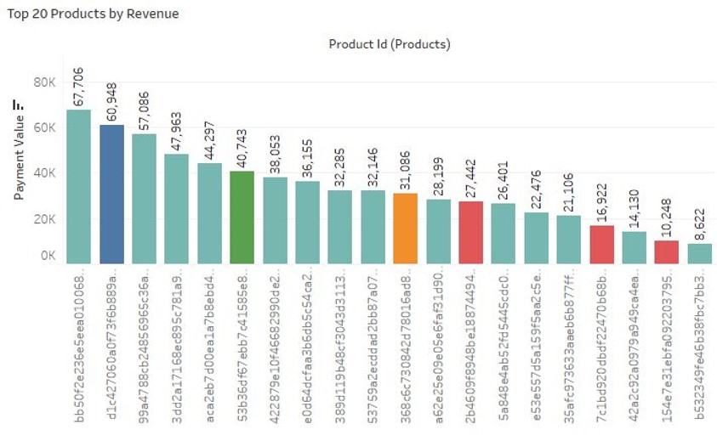
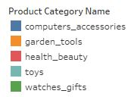
Visualizations Top 20 Ordered Products by Revenue
A product in the Toys category has generated the highest revenue, totaling 67,706.
Similarly, most of the top 20 revenue-generating products are from the Toys category.

Slide 8
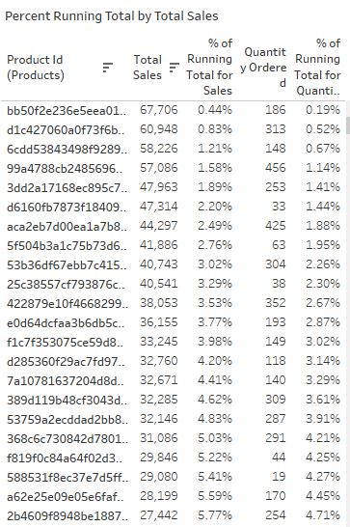
Visualizations Percent Running Totals
By analyzing the percentage of total running revenue and the quantity ordered for each product by Product ID, we've gained a clear understanding of how much each product contributes to our overall revenue.
This approach helps us pinpoint which product categories are driving our sales and where there might be opportunities for improvement or expansion.

Slide 9
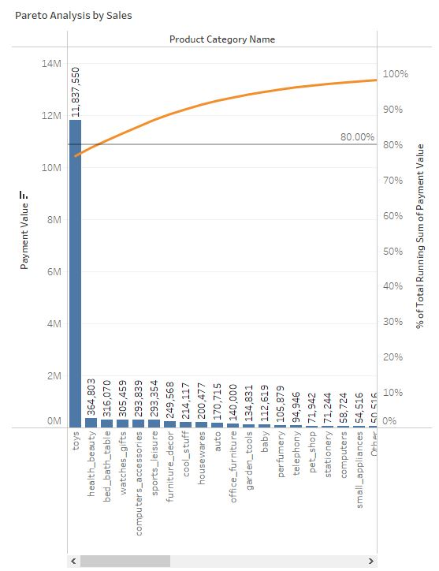
Visualizations Revenue Pareto
Three product categories—Toys, health_beauty, and bed_bath_table together generate 80.91% of our total revenue.
Notably, the Toys category alone accounts for 76.77%, with the remaining 70+ product categories collectively contributing only 23.23%.

Slide 10
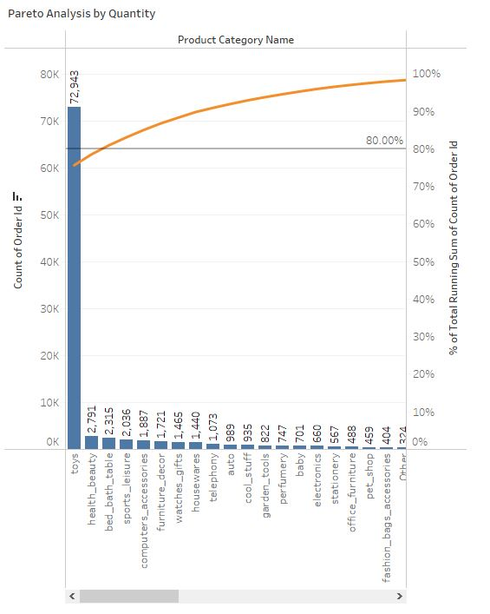
Visualizations Quantity Pareto
The product categories of Toys, health_beauty, and bed_bath_table represent 80.91% of our total orders.
Among these, Toys stand out, making up 75.62% of all orders, while the remaining categories combined account for only 24.38%.

Slide 11
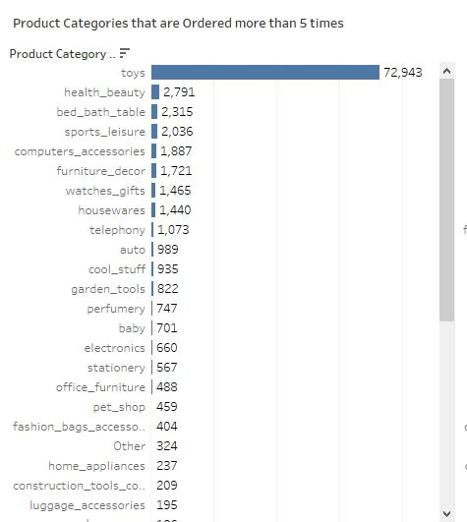
Visualizations Product Category Ordered > 5 Times
The Toys category leads the way with 72,943 orders, making it the most frequently purchased product type.
The health_beauty, bed_bath_table, and sports_leisure categories follow in order frequency, indicating that while Toys dominate, these other categories also hold some importance for our overall sales and customer interest.

Slide 12
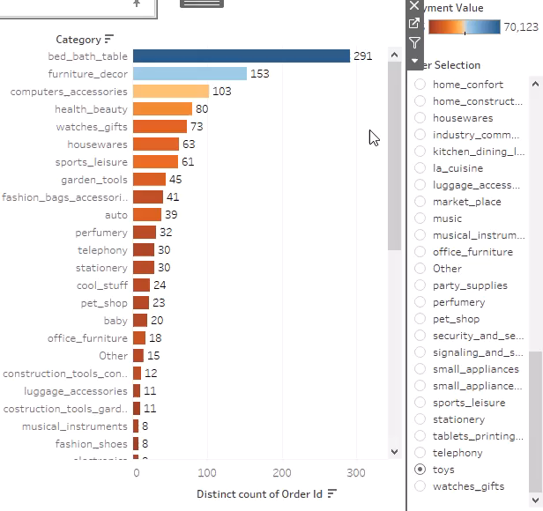
Visualizations Market Basket Analysis
Market Basket Analysis reveals that the Toys category frequently appears in orders with other specific categories, suggesting patterns of association in customer purchases.
Along with Toys, the categories often ordered together include bed_bath_table, furniture_decor, computer_accessories, and health_beauty.
This insight can guide targeted marketing efforts, cross-selling strategies, and product placement to capitalize on these commonly associated categories.

Slide 13
Key Insights Summary
Pareto Principle in Revenue: Toys, while accounting for only 20% of our product range, generate a remarkable 80% of the revenue, highlighting a disproportionate contribution to our earnings.
Demand for High-Value Products: Despite their higher prices, certain products continue to be top sellers, indicating that customers are willing to pay a premium for quality or specific features.
Category Associations in Orders: In addition to Toys, products from bed_bath_table, furniture_decor, computer_accessories, and health_beauty are frequently ordered, suggesting a broad range of customer interests.
Market Basket Trends: These key categories, whether individually or in combination with Toys, consistently appear in customers' baskets, pointing to common purchase patterns and opportunities for cross-selling and promotional strategies.

Slide 14
Recommendations
Optimize Inventory for High-Revenue Categories: Prioritize inventory management for categories that generate over 80% of the revenue, ensuring consistent product availability and reducing stockouts.
Leverage Customer Segmentation for Toys: Given that Toys is the most ordered category, develop targeted marketing campaigns and special offers to attract and retain customers who frequently purchase toys.
Promote Cross-Selling with Discounts: To encourage customers to purchase across categories, offer promotional codes or discounts for items frequently ordered in combination, such as Toys with bed_bath_table and furniture_decor. This strategy could drive larger basket sizes and increase overall sales.
Streamline Inventory by Reducing Low-Performing Subcategories: To improve efficiency and reduce costs, consider phasing out subcategories with minimal sales, allowing more focus on top-selling items and freeing up resources for high-demand products.

Slide 15
Appendix – Data Sources
Here’s an overview of our data dictionary, which includes key information categories:
Orders Data: Information about customer orders, including status and timestamps.
Order Items Data: Details about items in each order, including product, price and shipping charges.
Products Data: Product details, including category and physical dimensions.
Customers Data: Customer information, such as location.
Payments Data: Payment details for each order.
Our dataset, sourced from the Olist retail dataset, covers orders from 2016 to 2018. This comprehensive dataset provides a solid foundation for conducting thorough analyses and deriving meaningful insights into customer behavior, sales trends, and product performance.

Slide 16
Appendix – Data Methodology
Our data analysis process included:
Data Cleaning and Transformation: Cleaning and transforming the dataset using Python libraries (Pandas and Numpy) in Jupyter Notebook.
Handling Missing Values: Replacing missing values with suitable alternatives.
Removing Redundant and Duplicate Records: Removing redundant and duplicate records, retaining only the occurrence.
Exploratory Data Analysis (EDA): Conducting exploratory data analysis using Python libraries (Matplotlib and Seaborn) in Jupyter Notebook.
Creating a Market Basket Dataset: Creating a new dataset for Market Basket Analysis, focusing on order id and product category name.
Visualizations and Market Basket Analysis: Performing various visualizations and Market Basket Analysis in Tableau.

Slide 17
Appendix – Data Assumptions
To maintain focus and relevance, we made the following assumptions:
Considered only cases with ‘delivered’ order status.
Assumed that the provided data achieved the desired revenue.
Assumed the company has no plans to expand to new warehouses.
Formulated recommendations under the assumption of continuous sales growth.

Slide 18
Conclusion
Our analysis of OList's marketing and retail data has yielded key insights into product performance, customer behavior and revenue generation. Here's how our recommendations can help OList improve its business:
Optimized Inventory: By focusing on high-revenue categories, OList can maintain a more efficient inventory, reducing costs and avoiding overstocking low-performing items.
Increased Sales: Targeted marketing strategies and cross-selling efforts can drive sales, leveraging the strong demand for toys and popular product combinations.
Improved Profitability: The recommended strategies aim to maximize revenue while reducing operational inefficiencies, leading to increased profitability for the company.
Implementing these recommendations will position OList for sustained growth and a more secure financial future, enabling the company to better meet customer demands and navigate an evolving retail landscape.

Slide 19

Thank you
Divik Dalesh Shah –
977971410t@gmail.com
Amol Salgare –
Amol.b.salagare@gmail.com

